Slide 2
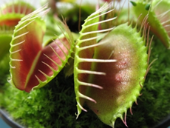
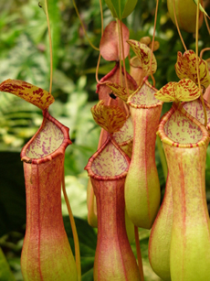
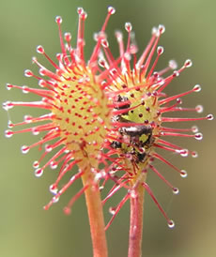
Carnivorous
Plants
Beautiful, Strange and Truly Wondrous
Dr. Sailesh B Prajapati
Assi. Prof. Government Science College, Chikhli, Dist. Navsari
psailesh4@gmail.com

Slide 3
Interesting Plants
If an animal eats a plant, it is of no particular interest; but when a plant eats an animal, that is of interest.

Slide 4
Where they are growing?
Soil with low mineral content (usually acidic)
Plenty of pure water (no salts, dissolved solids, metals, etc.)
Lots of sunlight
Little competition from alien species
Prey (mostly for flowering and fruiting)

Slide 5
Adapted for nutrient-poor soils, wet climates, bright light
Like all green plants, photosynthesize (I.e. they’re producers)
Attract and absorb macronutrients P-K-N (e.g. fertilizer) from prey

Slide 6
Genera of Carnivorous Plants
Over 600 Species; three basic trapping mechanisms
Active traps
(“steel trap” and “trap door”)
Aldrovanda
Dionaea
Utricularia
Sticky traps
(flypaper)
Byblis
Drosera
Drosophyllum
Pinguicula
Pitfall traps
(pitchers)
Darlingtonia
Cephalotus
Heliamphora
Nepenthes
Sarracenia

Slide 7
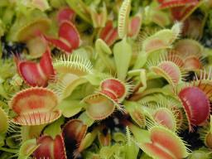
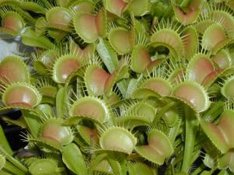
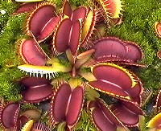
Venus Flytrap Dionaea muscipula
Active traps

Slide 8
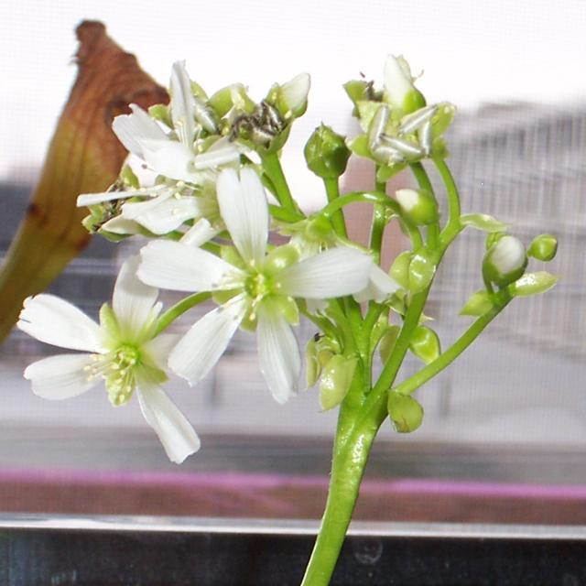
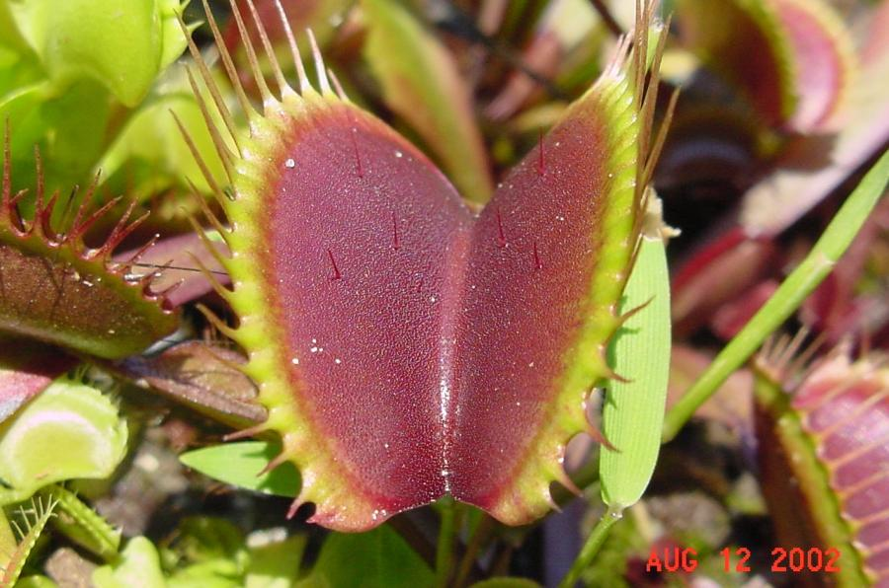
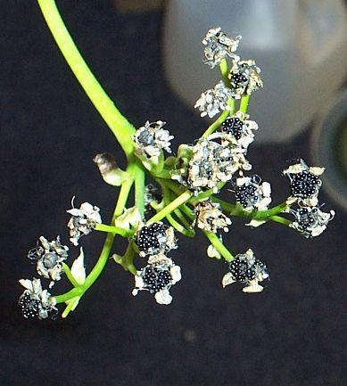
Venus Flytrap Dionaea muscipula
Trigger hairs
Flowers and seeds

Slide 9
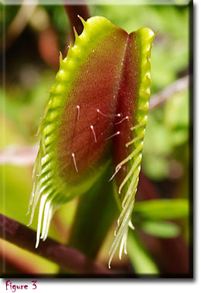
The plant then secretes an enzyme which essentially 'dissolves' the insect, turning it into a digestible dinner.

Slide 10
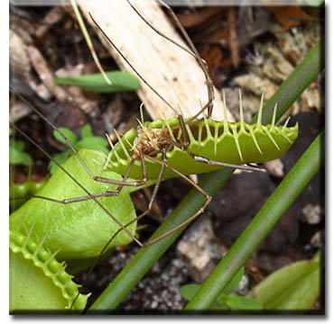
After a few days, the fly trap will re-open, to await it's next victim. Yummmmm!

Slide 11
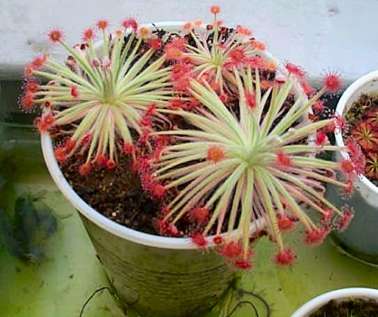
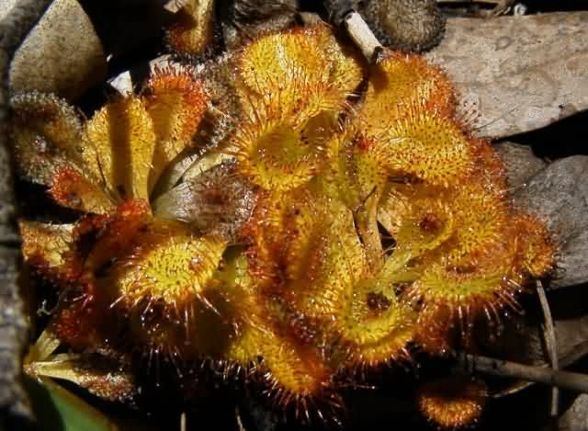
Drosera – The Sundews
Sticky traps

Slide 12
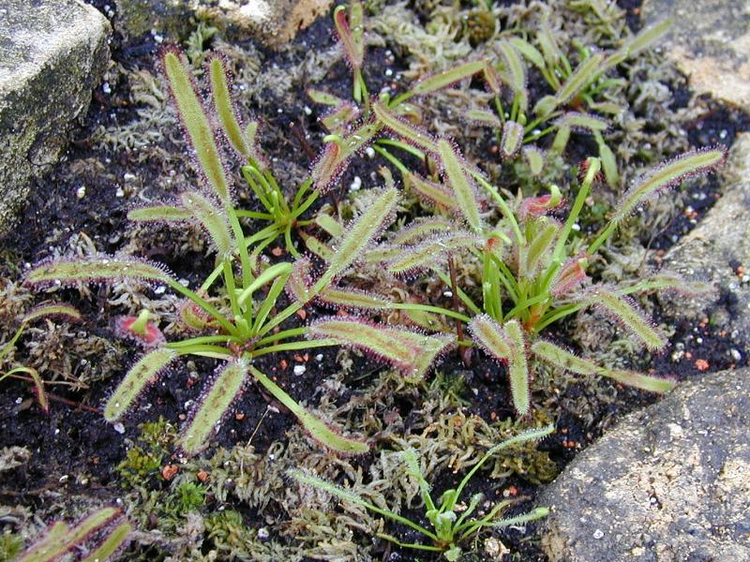
Drosera capensis

Slide 13
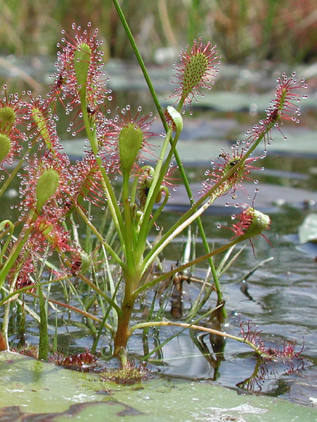
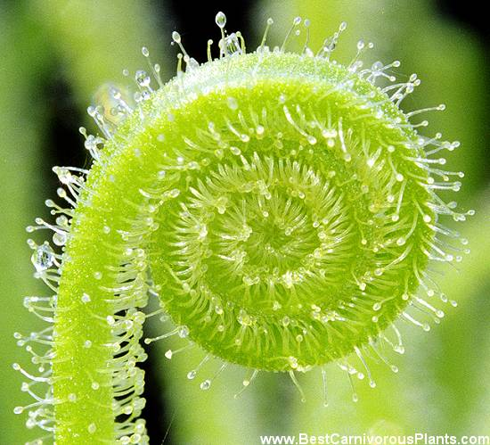
Spatulate-leaved Sundew
Drosera intermedia

Slide 14
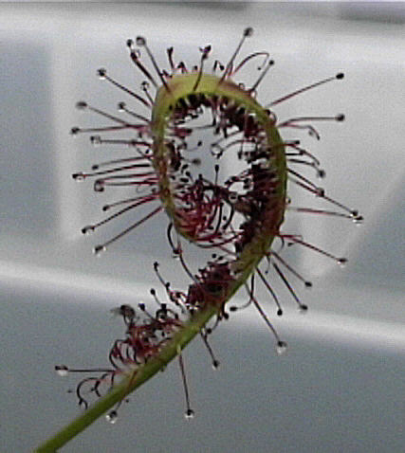
Drosera capensis in action!!!
Sticky traps
+
Leaf blade movement to aid digestion

Slide 15
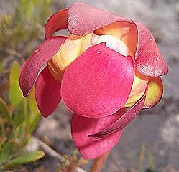
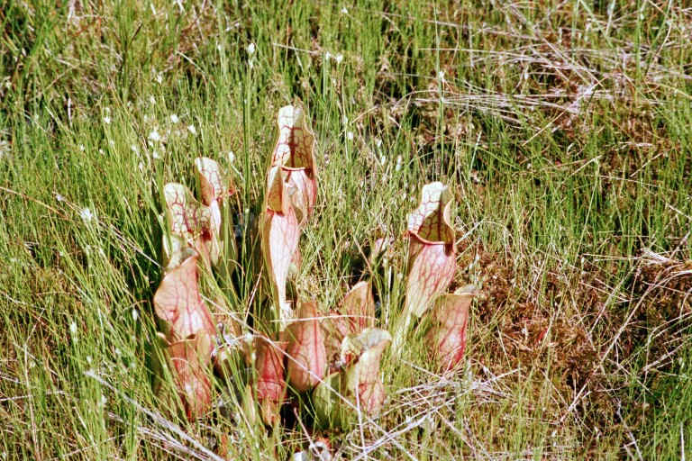
Sarracenia - North American Pitcher Plants
Pitfall traps
S.purpurea

Slide 16
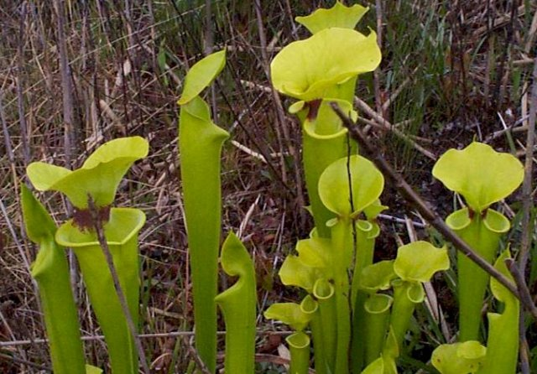
Sarracenia flava

Slide 17
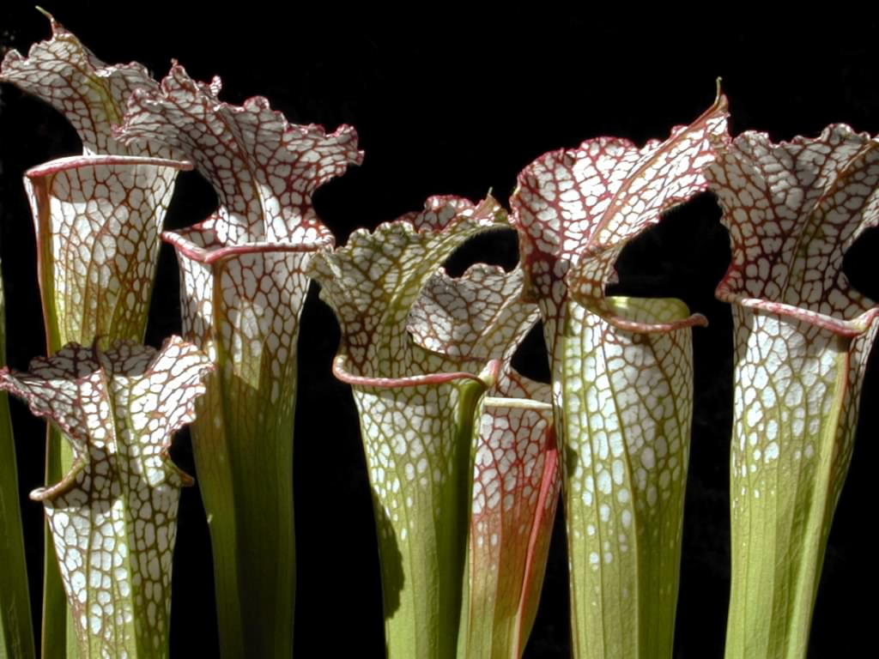
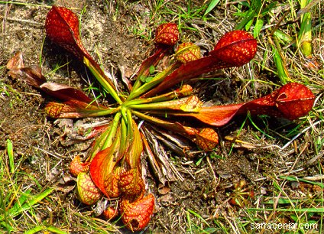
Sarracenia leucophylla and Sarracenia psittacina

Slide 18
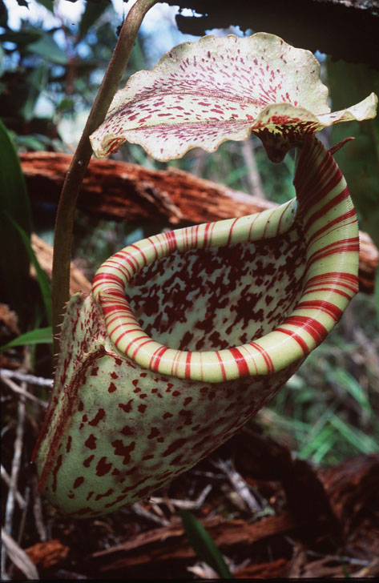
Nepenthes - “Monkey Cup” Tropical Vine Pitcher Plant
N.burbidgeae
Pitfall traps

Slide 19
Nepenthes -
Pitcher size from 1” to more than 2 liters
Leaves up to 1 meter length
Some scramble, some climb many meters
Rats and baby monkeys have been found in pitchers

Slide 20
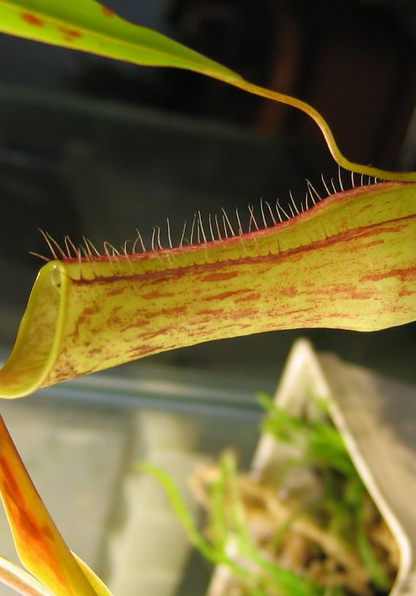
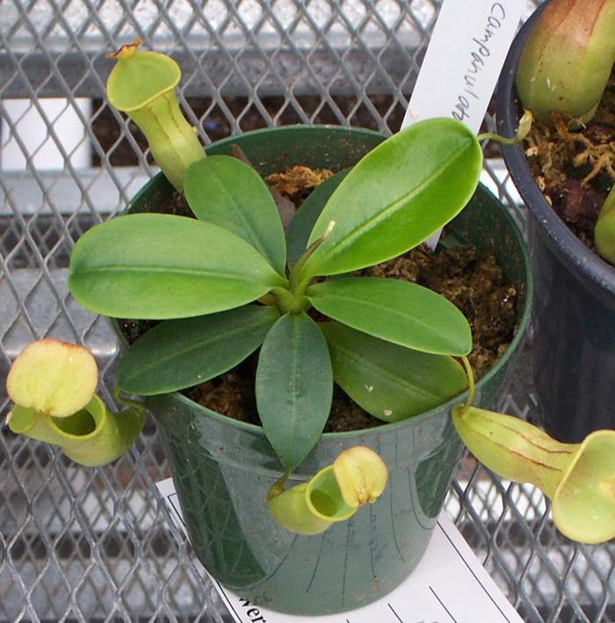
Nepenthes campanulata
Lowland species
Nepenthes gracilis

Slide 21
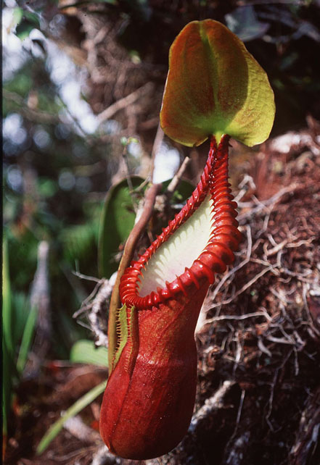
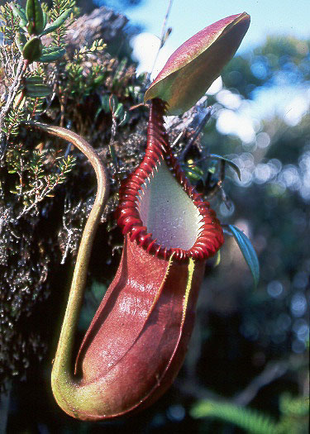
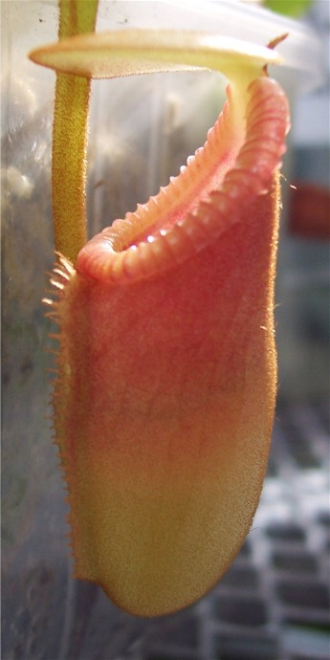
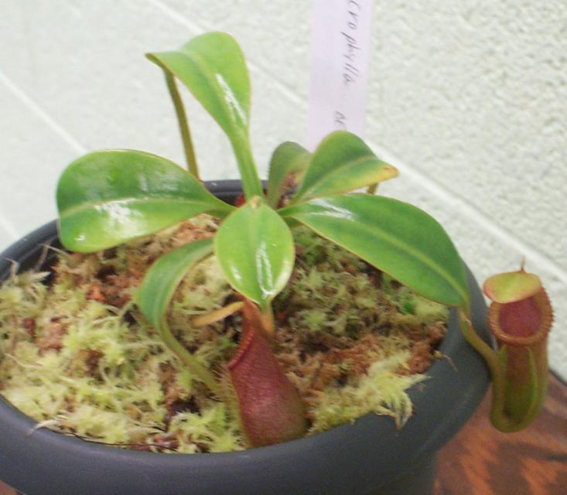
Nepenthes macrophylla
Highland species

Slide 22
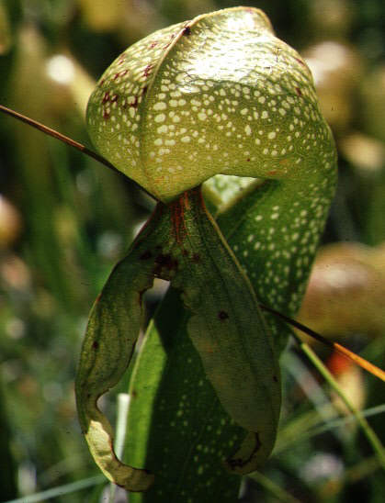
Darlingtonia californica Cobra Lily
Pitfall traps

Slide 23
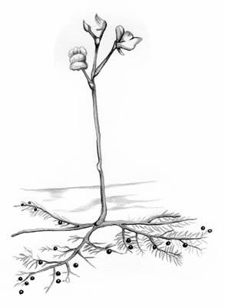
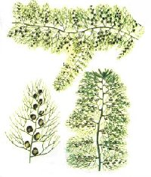
Bladderwort

Slide 24
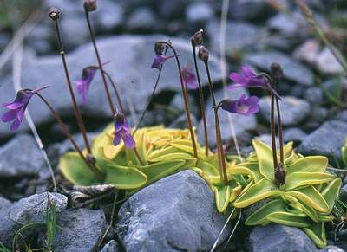
Butterwort Pinguicula vulgaris

Slide 25
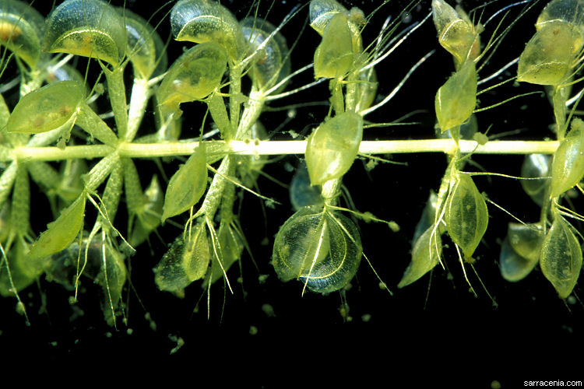
Waterwheel Plant Aldrovanda vesiculosa

Slide 26
Most are extremely endangered:
Development of the coastal swamps
Deforestation
Pollution of wetlands
Imported competition

Slide 27
THANKS

